Slide 1
TRAFFIC SIGN RECOGNITION USING DEEP LEARNING
Team Details
G. Sanjay Deep (20EG105414)
V. Hemanth (20EG105450)
D. Nithin Reddy (20EG105408)
Project Supervisor
Name : Mr. E. Radha Krishnaiah
Designation : Assistant Professor

Slide 2
Introduction
With the rapid development in societal and economical section, automobiles have become almost one of the convenient modes of transportation in each household.
As one of the more important functions, traffic sign detection and recognition system, has become a hot research direction of researchers at home and abroad.
In the current traffic system there may be the probability of drivers missing the traffic sign because of traffic or even the drivers might ignore the traffic sign. With the continuous growth of urbanization this problem is only expected to grow worse.

Slide 3
Introduction
Applications:
Traffic sign classification
Lane detection and management
Speed limit recognition
Stop sign detection
Wrong way detection

Slide 4
Literature
Author(s) | Method | Advantages | Disadvantages
Kaoutar Sefrioui Boujemaa, Afaf Bouhoute, Karim Boubouh and Ismail Berrada | Convolutional Neural Networks | High accuracy in image classification tasks, making them well-suited for traffic sign recognition. | Facing issues in resource-constrained environments, such as in embedded systems.
Prashengit Dhar, Md. Zainal Abedin, Tonoy Biswas, Anish Datta | Convolutional Neural Networks | Real-time alerts about speed limits, warnings. | Adverse weather conditions like heavy rain, snow, or fog can affect the performance of the recognition system, reducing its reliability.
Faming Shao, Xinqing Wang, Fanjie Meng, Ting Rui, Dong Wang, and Jian Tang | Simplified Gabor Wavelets | Gabor wavelets helping to differentiate between different sign types. | It focus on individual features of traffic signs.
Shopa, Sumitha & Patra | OpenCV (Open Source Computer Vision Library) | Real-time image processing. | Daily implementation required.
Faming Shao, Xinqing Wang, Fanjie Meng, Ting Rui, Dong Wang, and Jian Tang | Simplified Gabor Wavelets and CNNs | It handle variations in lighting conditions and making them robust for real-world scenarios. | It doesn’t show variations in traffic sign designs, colors, and shapes.

Slide 5
Problem Statement
The challenge is to develop a computer vision system that can accurately detect and classify traffic signs within images, even in adverse weather conditions that affect image quality. The primary objective is to enhance road safety by providing drivers with real-time, dependable information.
Objective
The primary objective of traffic sign recognition is to enhance road safety by automatically detecting and interpreting traffic signs. This technology helps drivers by providing real-time information about speed limits, warnings, and other important instructions, reducing the risk of accidents and improving overall traffic management. Additionally, it can support advanced driver assistance systems (ADAS) and autonomous vehicles in making safer driving decisions.

Slide 6
Proposed Method
By applying deep learning to this problem, we create a model that reliably classifies traffic signs, learning to identify the most appropriate features for this problem by itself.
A deep learning based road traffic signs recognition method is developed which is very promising in the development of Advanced Driver Assistance Systems (ADAS) and autonomous vehicles.
The system architecture is designed to extract main features from images of traffic signs to classify them under different categories.
The training is conducted using the Traffic Sign Dataset and achieves good results on recognizing traffic signs.

Slide 7
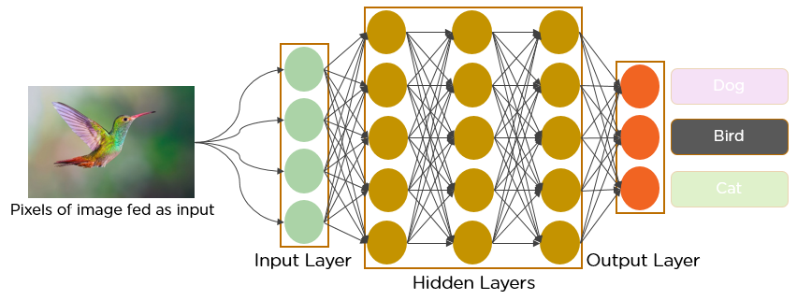
Proposed Method
CONVOLUTIONAL NEURAL NETWORKS(CNN):
It is assumed that the reader knows the concept of Neural networks. When it comes to Machine Learning, Artificial Neural Networks perform really well. Artificial Neural Networks are used in various classification tasks like image, audio, words.
Different types of Neural Networks are used for different purposes, for example for predicting the sequence of words we use Recurrent Neural Networks more precisely an LSTM, similarly for image classification we use Convolution Neural networks.

Slide 8
Technologies used
PYTHON
CONVOLUTIONAL NEURAL NETWORKS(CNN)
DEEP LEARNING
TENSORFLOW

Slide 9
Project status
S.No | Functionality | Status (Completed /in-progress/Not started)
1 | Data collection and Extraction | Completed
2 | Designing Convolutional Neural Networks (CNN) | Completed
3 | Creating the Deep Learning model | In-progress
4 | Building the model | In-progress
5 | Recognition and Classification | Not yet started

Slide 10
References
Rajesh Kannan Megalingam ⇑ , Kondareddy Thanigundala, Sreevatsava Reddy Musani, Hemanth Nidamanuru, Lokesh Gadde
Link: https://www.sciencedirect.com/science/article/pii/S2046043022000557?via%3Dihub

Slide 11
Thankyou..!

